Slide 1

Micromechanical Exfoliation of Graphene
Supervisor : Dr. Pranay Ranjan
Viraj Jagdale (B20MT050)

Slide 2
Contents
Types of Materials (Based on dimensions)
2D Materials
Graphene
Properties of Graphene
How to clean wafers and obtain Graphene?
Observations
Conclusion
Application

Slide 3
Types of Materials (based on dimensions)
0D Material : Material with all three dimensions are confined. Ex. Quantum Dot.
1D Material : Material with 2 of the dimensions are confined. Ex. Carbon Nanotube.
2D Material : Material with 1 of the dimensions are confined. Ex. Graphene, Borophene.
3D Material : Naturally obtaining materials

Slide 4
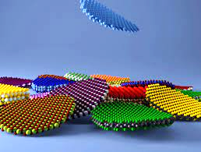
2D Materials
Nano - Material : High surface to volume ratio
One Dimension is confined (less than 100 nm)
Application of 2D materials:
Strain Sensors
Nanogenerators
Innovative nanoelectromechanical systems (NEMS)
Batteries
Image from EPFL & NCCR Marvel

Slide 5
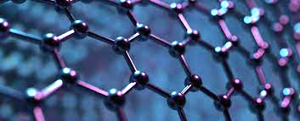
Graphene
Single layered structure of carbon atoms arranged in two-dimensional honeycomb like nanostructure
First 2D Material
Covalent bonding between two carbon atoms whereas van der waals force of attraction between two sheets(stacking force)
Van der waal Material : as stacking force is Van Der Waals force of attraction
97.7% Transparent

Slide 6
Graphene
Strongest material available
100 times better mechanical properties than steels
Highly conductive material at room temperature
10 times higher thermal conductivity than copper
0 Bandgap semiconductor

Slide 7
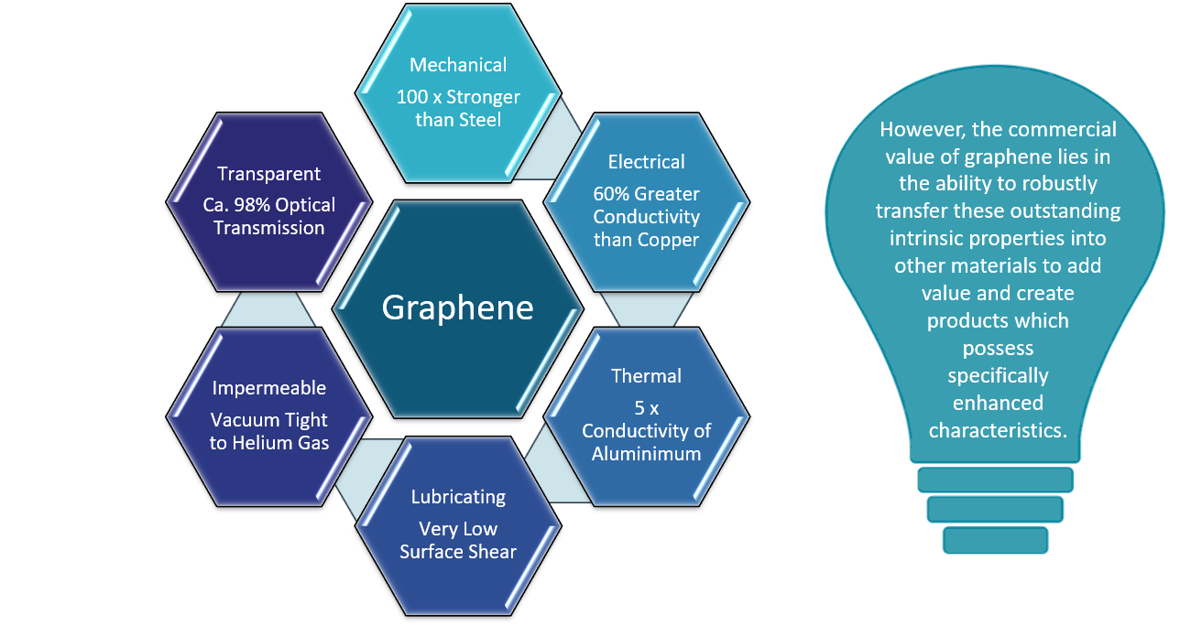
Properties of Graphene
Planar Density : 0.77 mg/m²
Tensile Strength : 125 GPa
Elastic Modulus : 1.1 TPa (most common steels have 200 GPa)
Breaking Strength : 42 N/m
Electron Mobility : 2 × 105 cm2/Vs
Electrical Conductivity : 10⁶ S/m
Sheet Resistance : 31 Ω/sq
Thermal Conductivity : 5300 W/mk

Slide 8
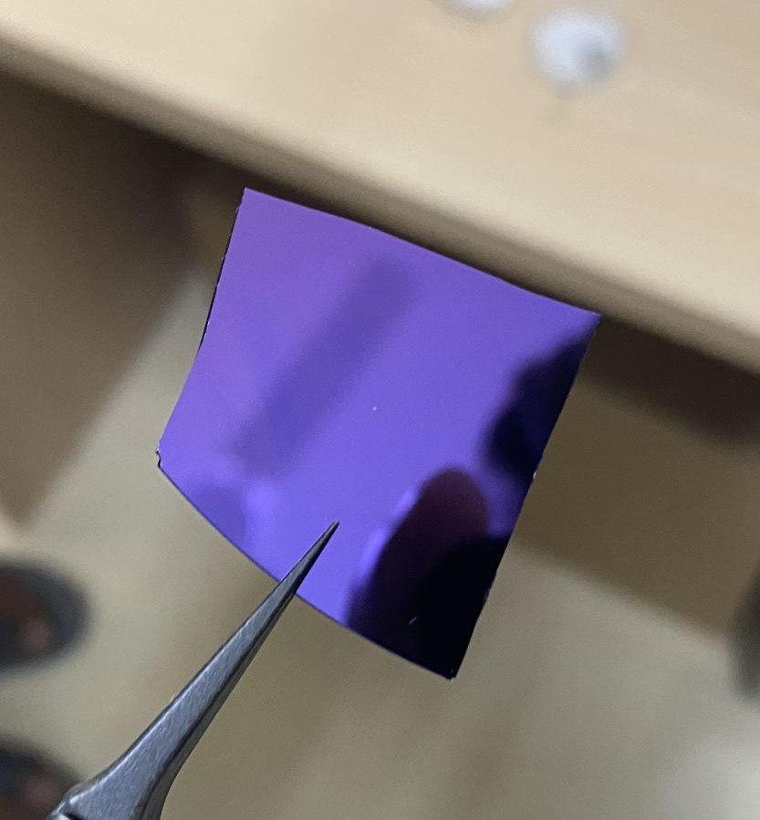
How to clean wafers & obtain Graphene?
Step 1 : Cleaning of Substrate (P-type Silicon Wafers) - To remove dust particles
Acetone
IPA (isopropyl alcohol) or ethanol
DI water
Nitrogen Air
P-type Silicon Wafer

Slide 9
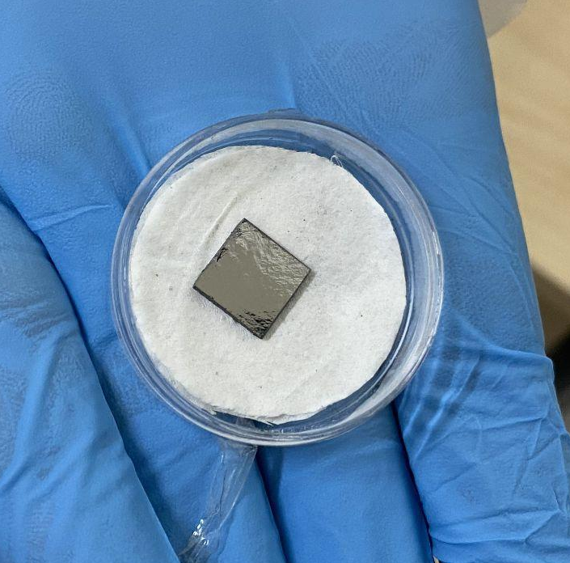
How to clean wafers & obtain Graphene?
Step 2 : Cutting of Substrate with diamond cutter
Step 3 : Exfoliation of Graphene Sheets from HOPG (highly oriented pyrolytic graphite) using scotch tape
HOPG

Slide 10
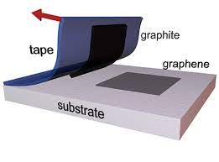
How to clean wafers & obtain Graphene?
Step 4: Transfer these sheets to another scotch tape to get thinner layers of graphene

Slide 11
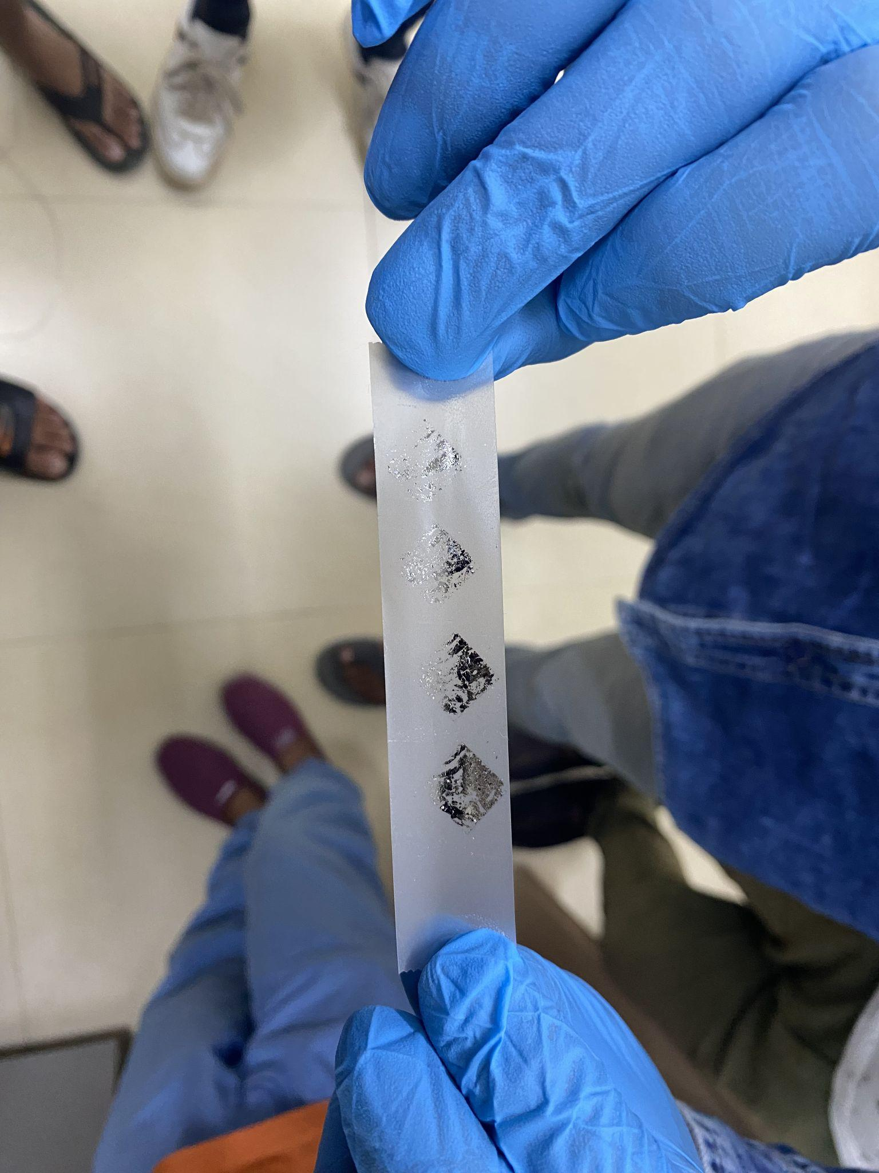
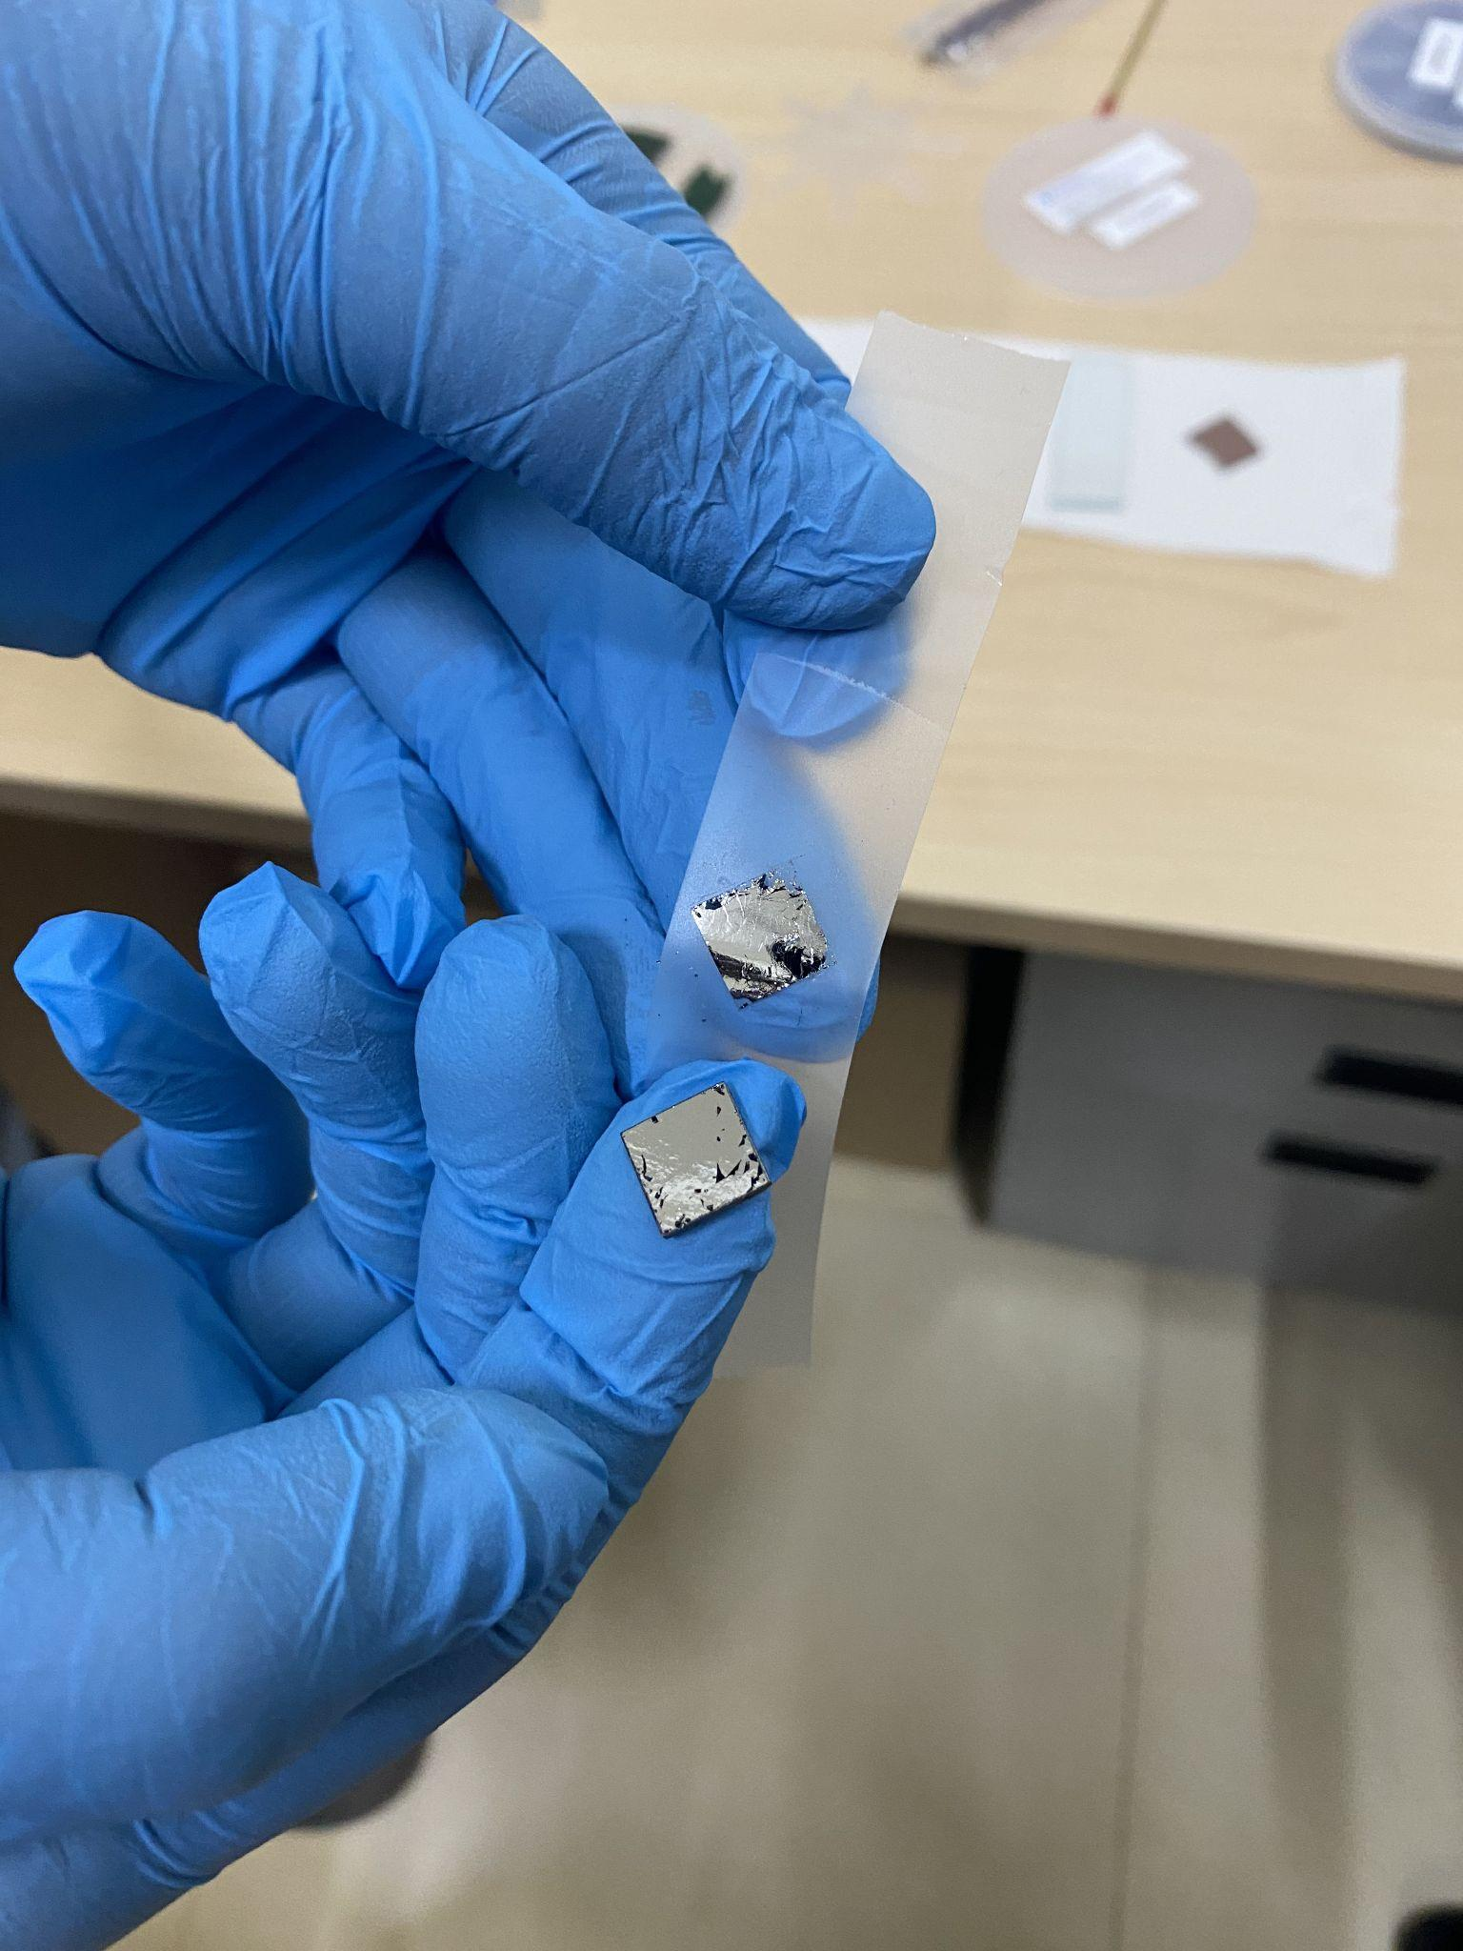
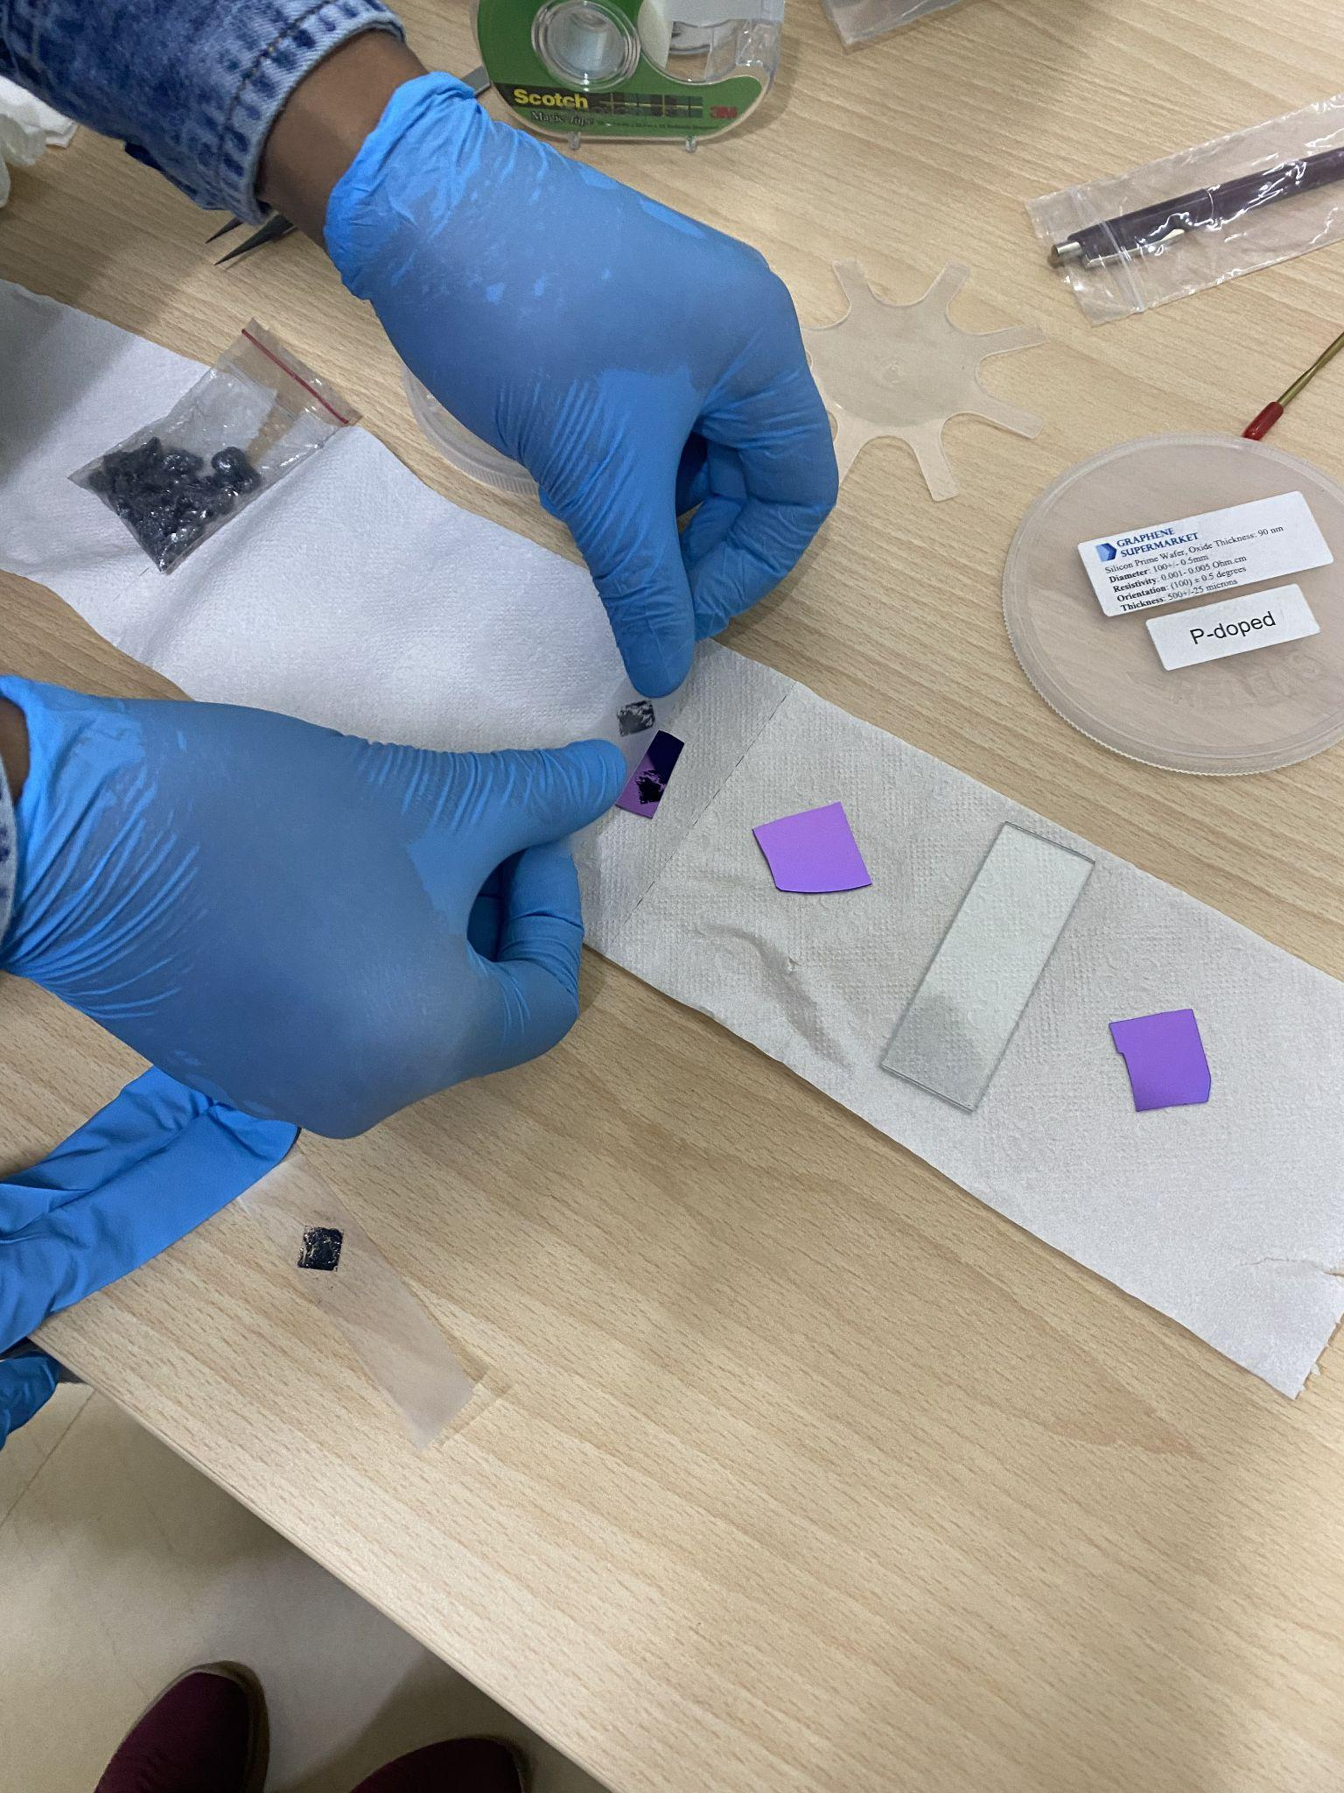
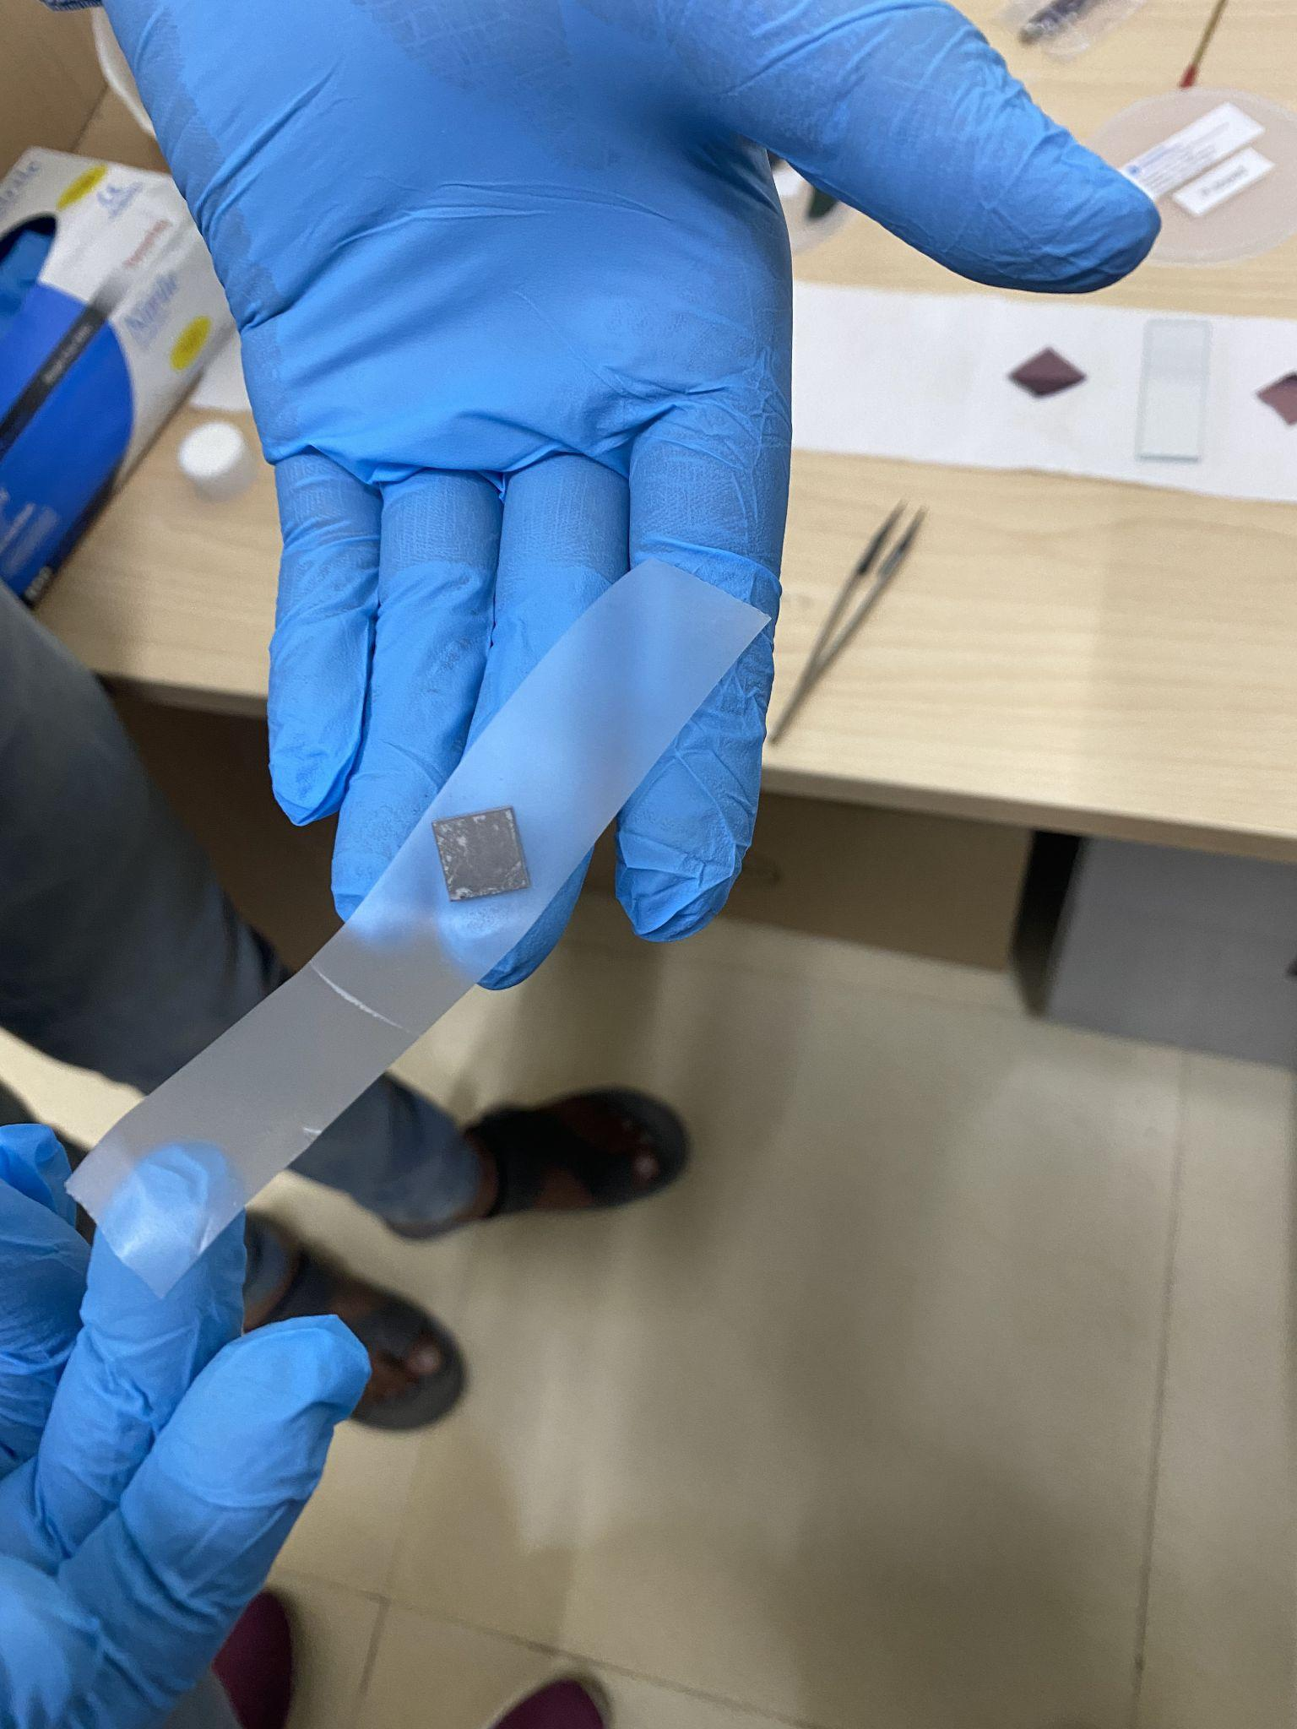
How to clean wafers & obtain Graphene?

Slide 12
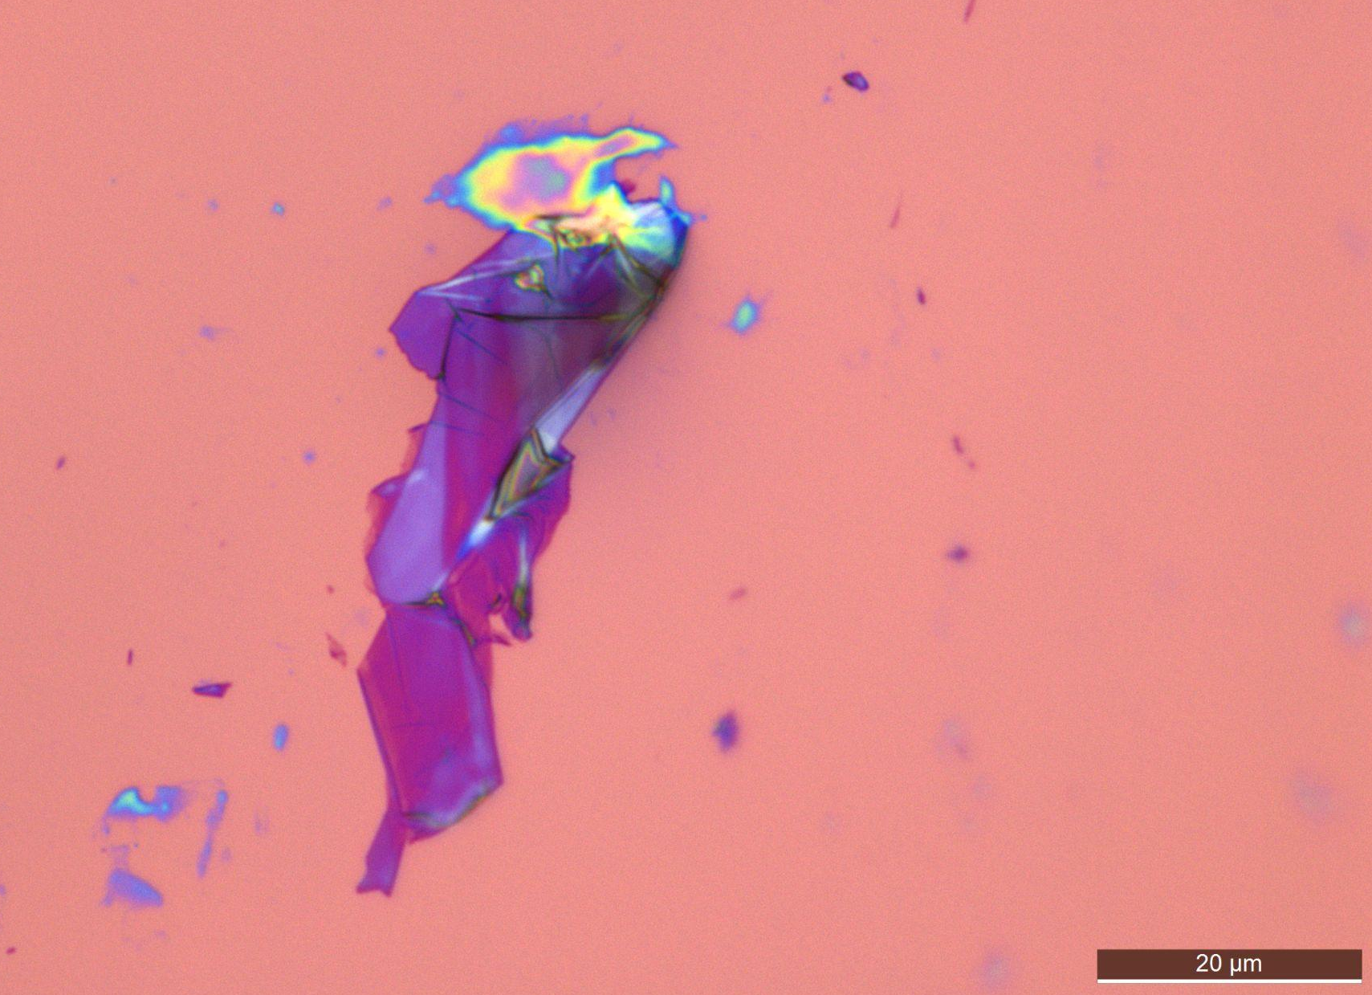
Observations
Glue
Multi-layered Graphene
Solvent

Slide 13
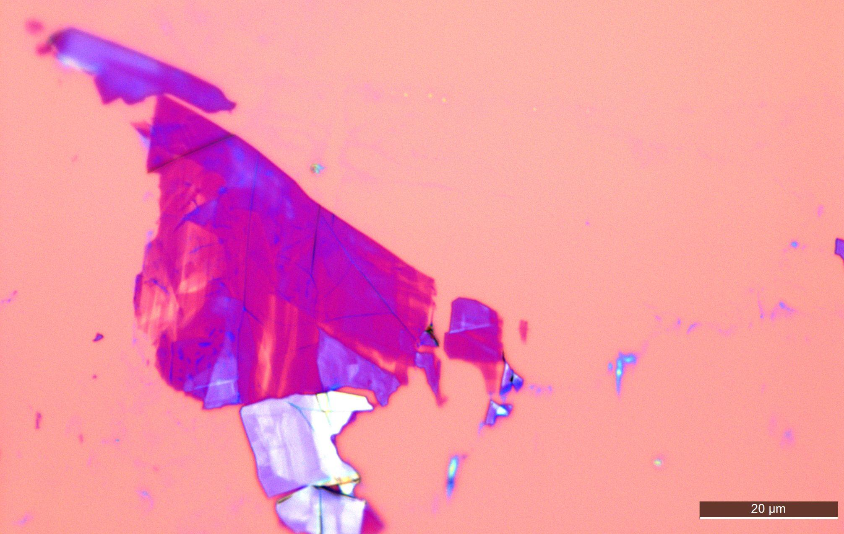
Observations
Thin layers of Graphene
Multi-layered Graphene

Slide 14
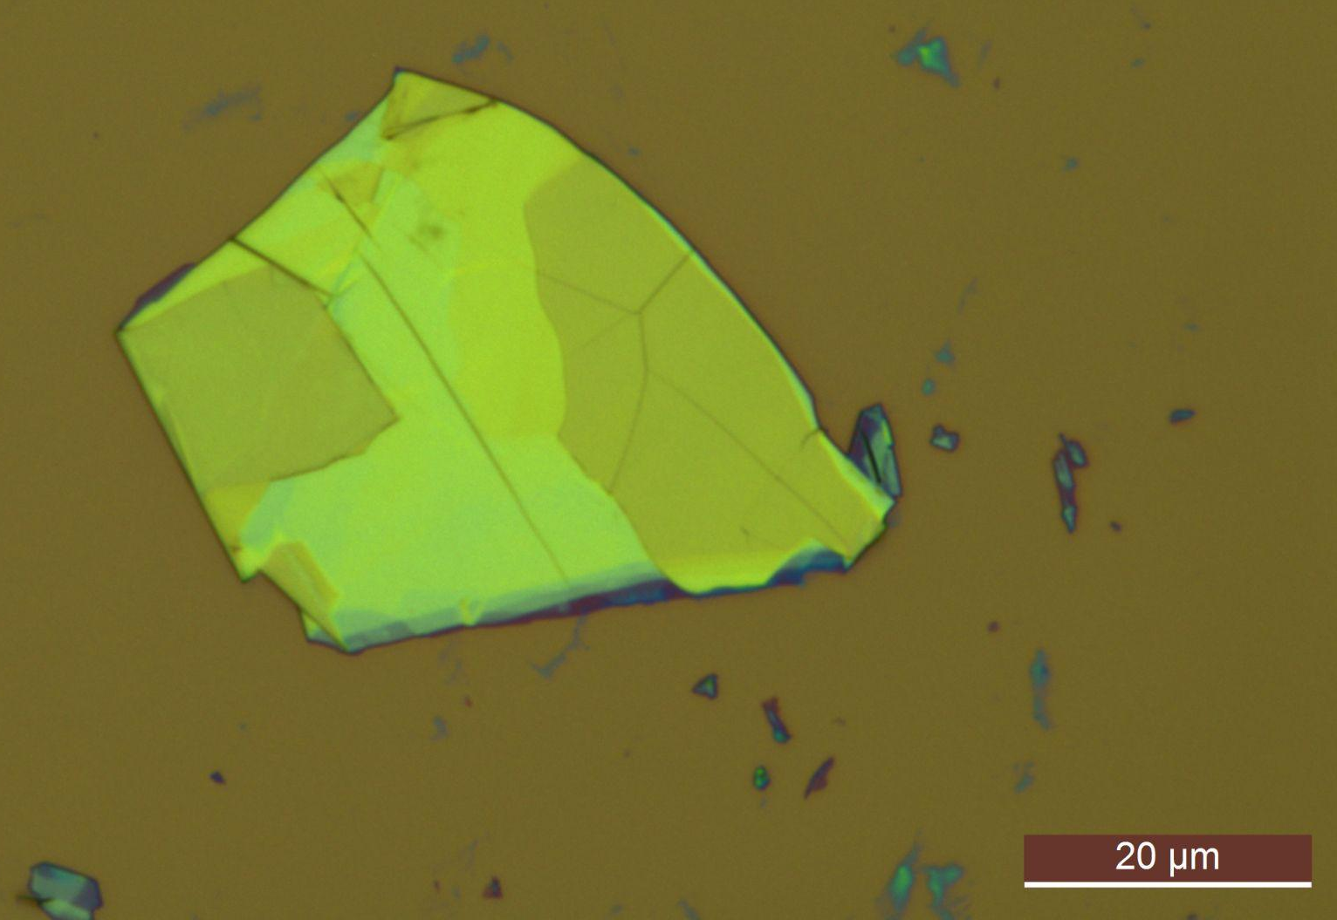
Observations
Thin Layers of Graphene
Solvent or Glue

Slide 15
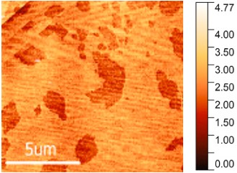
Observations
Graphene Sheets
nm

Slide 16
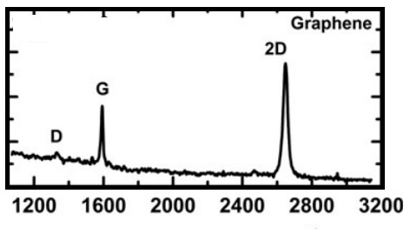
Observations

Slide 17
Conclusion
The material has been found to be made in right phase and purity

Slide 18
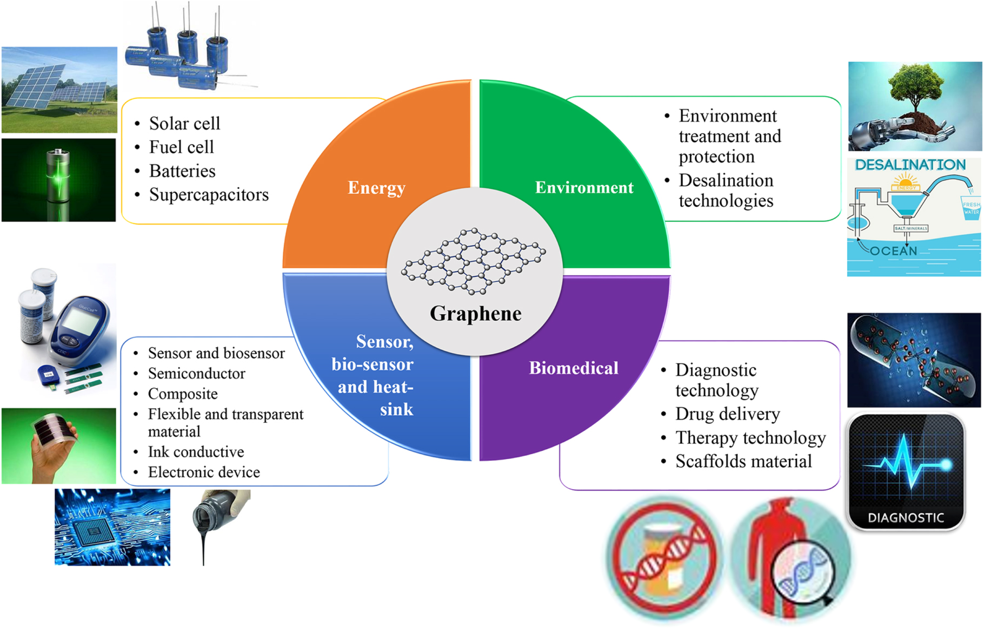
Application of Graphene
Madurani, Kartika A., et al. "Progress in graphene synthesis and its application: history, challenge and the future outlook for research and industry." ECS Journal of Solid State Science and Technology 9.9 (2020): 093013.

Slide 19
Acknowledgement
Arshiya Ansari
Moin Ali Siddiqui
Shahzad Ahmed

Slide 20
Thank You

